Slide 1
AESTHETICS
AN INTRODUCTION TO PRODUCTION DESIGN FOR THEATER

Slide 2
OBJECTIVES
Identifying Production Design (Activity)
Introduction to Production Design (Activity)
Being a designer
Basic PD Elements and Fundamentals
Wrap up Activity

Slide 3
ACTIVITY 1
Sketch a stage design
in 10 minutes

Slide 4
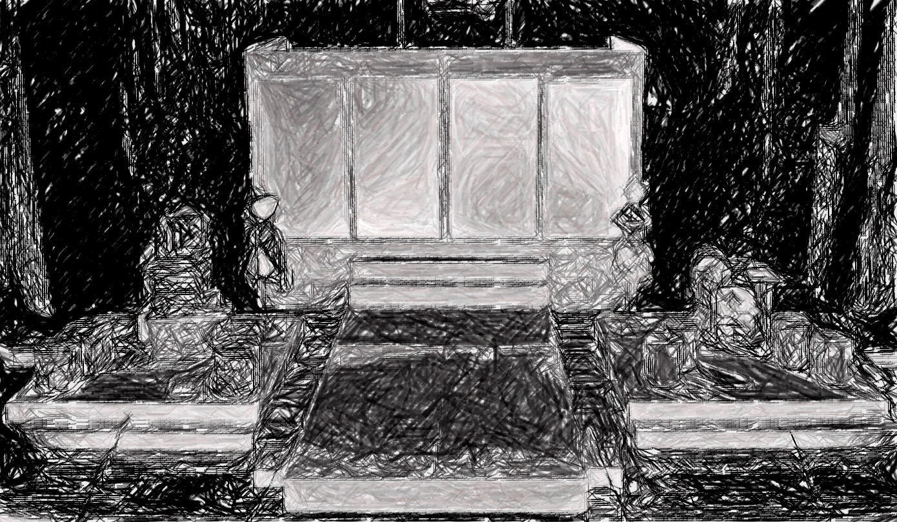
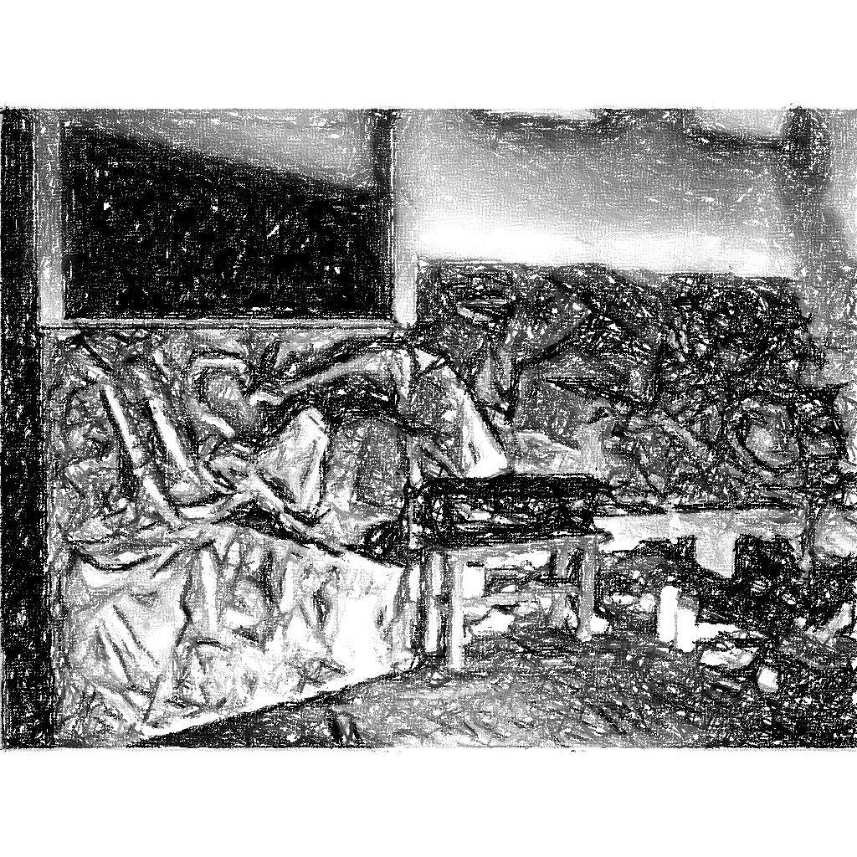
PD?

Slide 5
Over all look or feel of the production or setting.
Body of the play.

Slide 6
Designer

Slide 7
Head designer who works hand in hand mainly with the director, technical director, production manager and key aspects heads and designer.

Slide 8
TELL THE STORY.

Slide 9
MUSTS.
Love art
Be Creative
Flexible
Prepared
A keen observer
Know measurements
Think out of the box
Keep the design in unison
Have a self affirmation
Concern the whole
A listener

Slide 10
PD common problems
Budget
Time
Changes
Venue
Design Mechanics
Aspect coordination
Director
Designers

Slide 11
Resolutions
Plan everything first
Communication is essential
Research everything
Do oculars
Visualize with the key aspects
Immerse yourself

Slide 12
STEPS FOR BEGINNING A PRODUCTION DESIGN

Slide 13
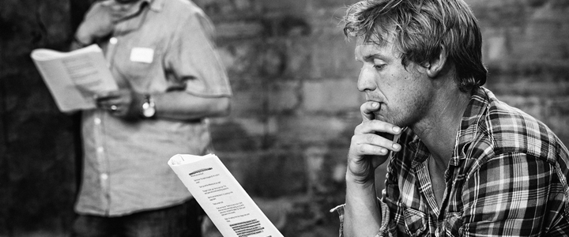
READ THE SCRIPT or at least listen to the script reading

Slide 14
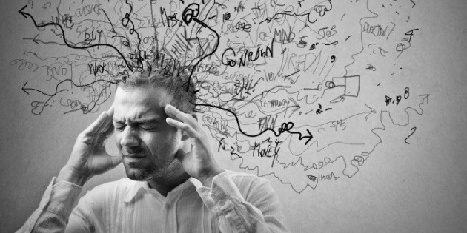
ANALYZE THE SCRIPT digest everything

Slide 15
DETERMINE THE OBJECTIVE

Slide 16
RESEARCH this is a must, seriously

Slide 17
COLLABORATE/ COMMUNICATE with the whole team

Slide 18
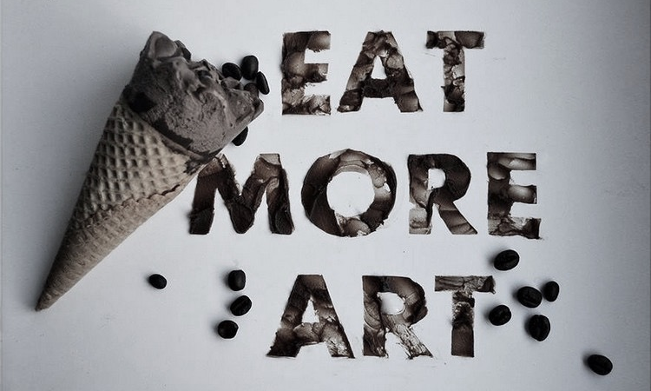
FEED YOUR ART Immerse yourself in art

Slide 19
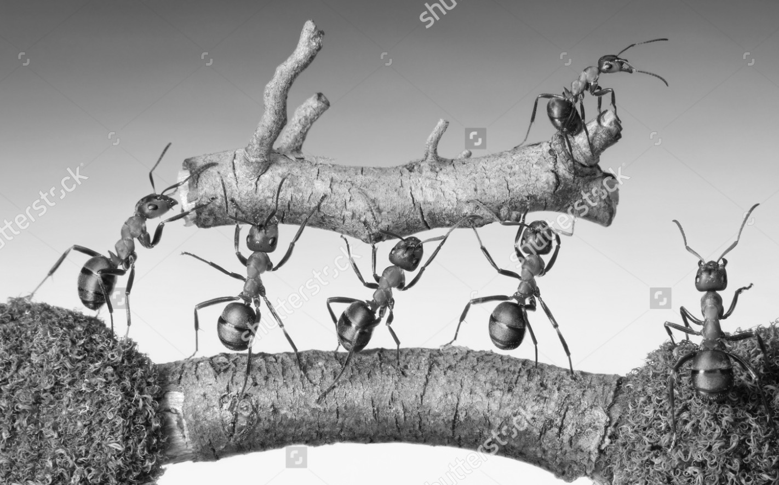
EXECUTE THE DESIGN you must work hand in hand

Slide 20
9 Objectives of a Theatrical Design

Slide 21
TIME
Day, Week, Month or Year
Friday mid day, early September
Dapithapon, kinaumagahan etc.

Slide 22
PERIOD
Historical age, decade or era
10th Century, Stone age period etc.

Slide 23
PLACE
Specific setting
Living room, bathroom, office etc.

Slide 24
LOCALE
A greater geographic or regional location of the play
Country, continent etc.

Slide 25
THEME
What makes you think about. The dress of the play

Slide 26
MOOD
The emotional impact of the audience. It is how we see and feel the scene

Slide 27
STYLE
Close related with the theme. The art movement applied to the story to deliver the message in a most profound way

Slide 28
REVEALING CHARACTER
Studying the whole character

Slide 29
SOLVING PRACTICAL PROBLEMS
Budget
Labor
Time

Slide 30
ART MOVEMENTS The isms of art

Slide 31
NATURALISM
Portraying life on stage with close attention to detail.
Nature vs. nurture
Natural order of things, survival, notions of evolution

Slide 32
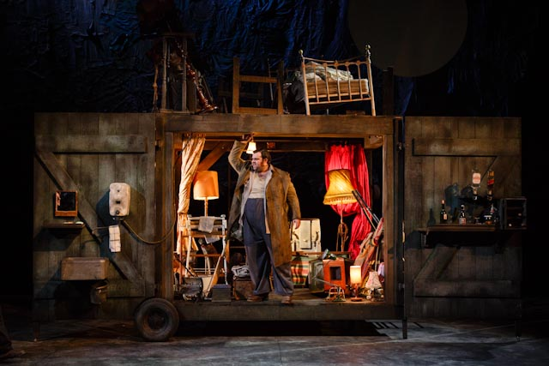
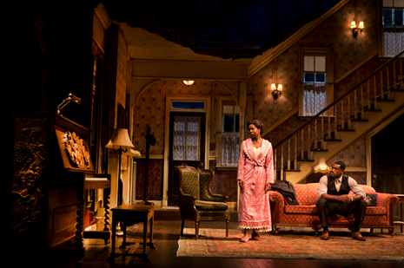
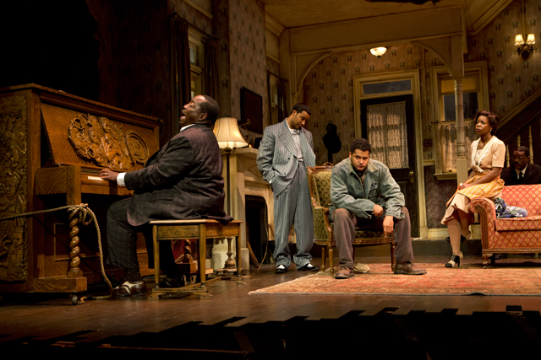
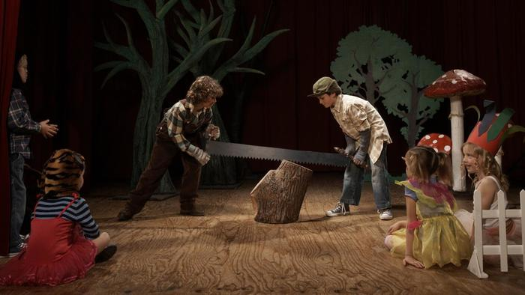

Slide 33
REALISM
Realistic Setting
Normal life

Slide 34
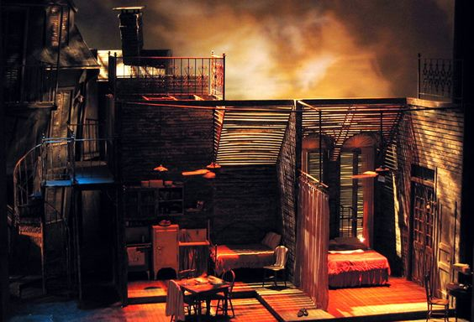
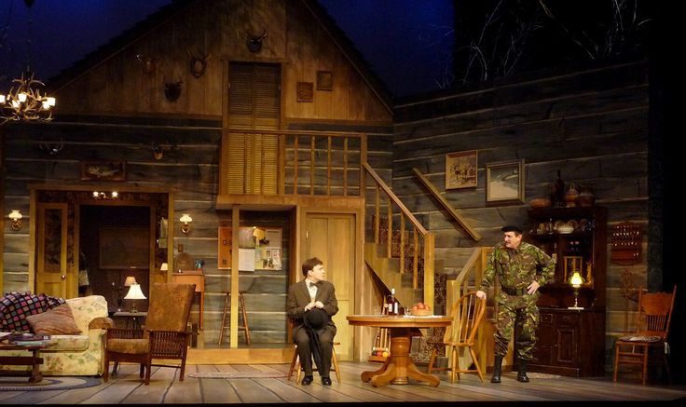

Slide 35
EXPRESSIONISM
Unrealistic or distorted appearance on stage to portray an eternal truth

Slide 36
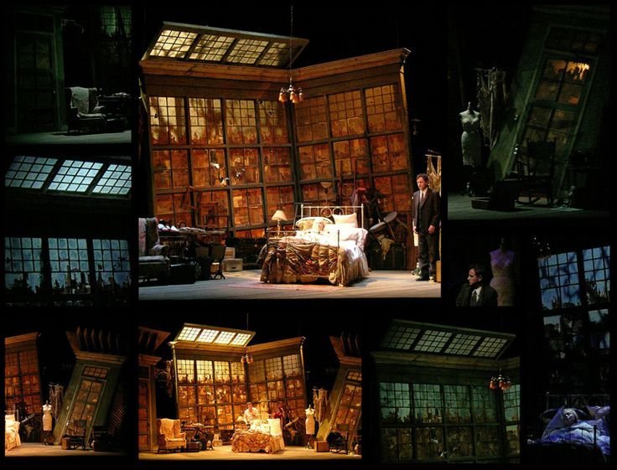
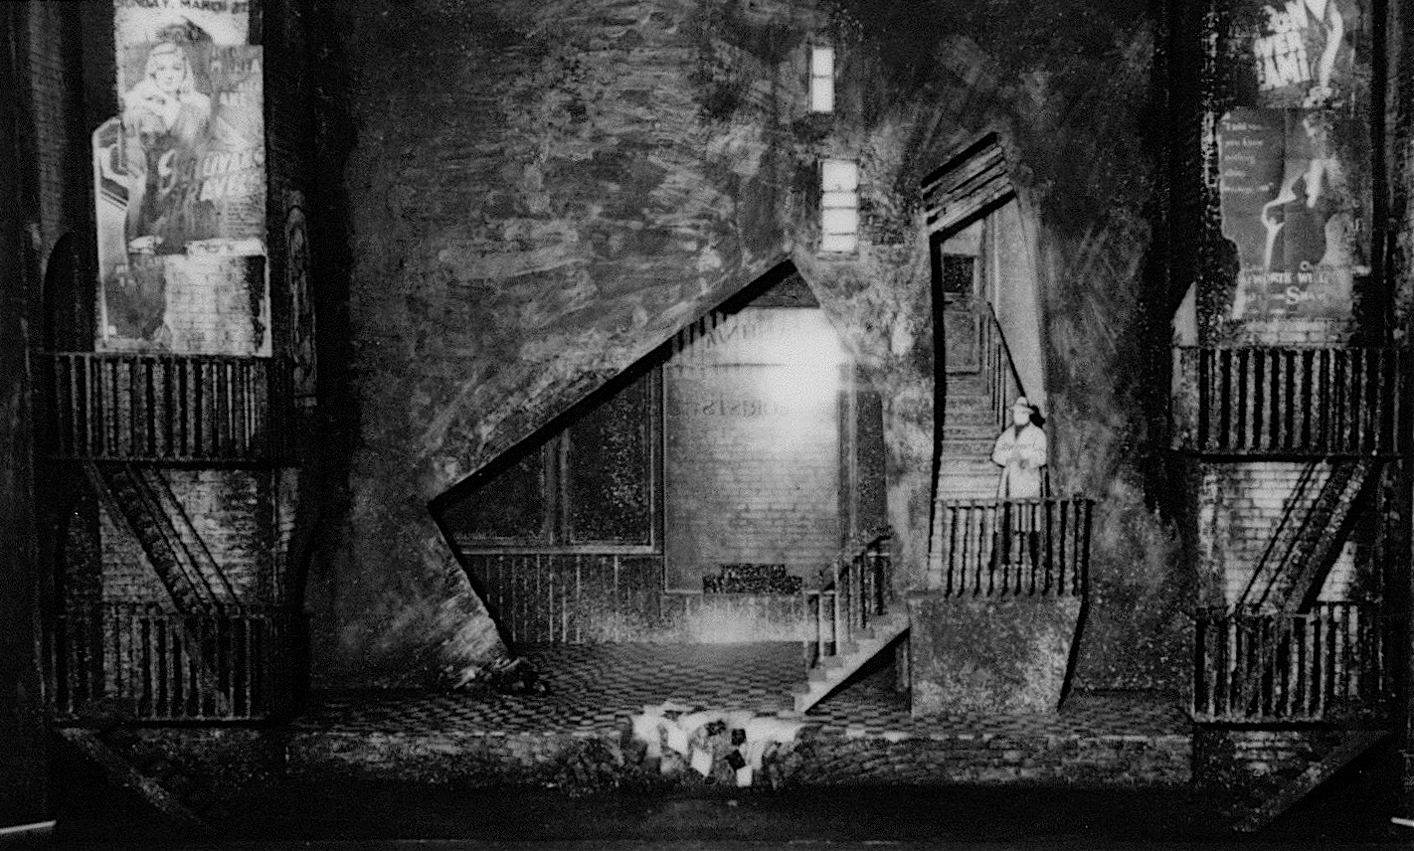

Slide 37
MODERNISM
A broad concept that sees art, including theater, as detached from life in a pure way and able to reflect on life critically.

Slide 38
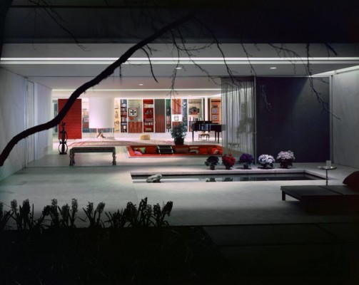
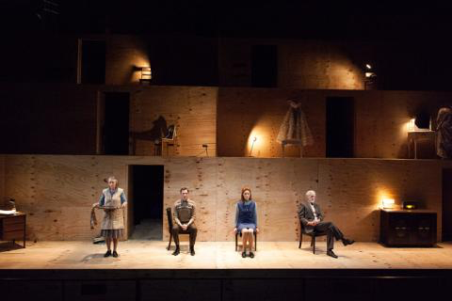

Slide 39
POST MODERNISM
This approach often uses other media and breaks accepted conventions and practices.

Slide 40
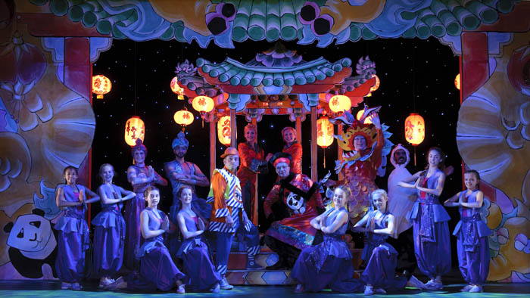
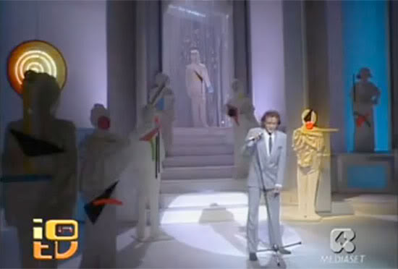

Slide 41
CLASSICAL
This approach often uses other media and breaks accepted conventions Classical theatre usually contains lofty, grand prose or free verse dialogue.

Slide 42
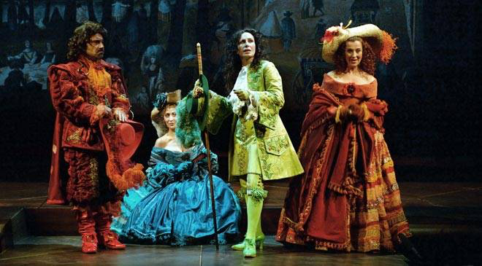
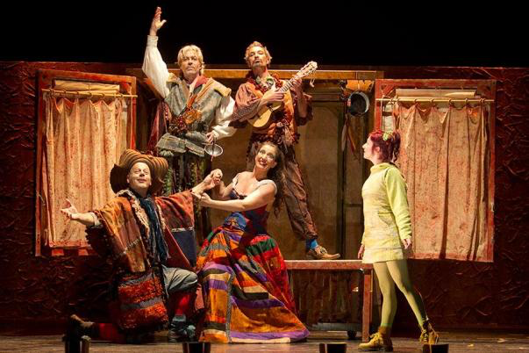
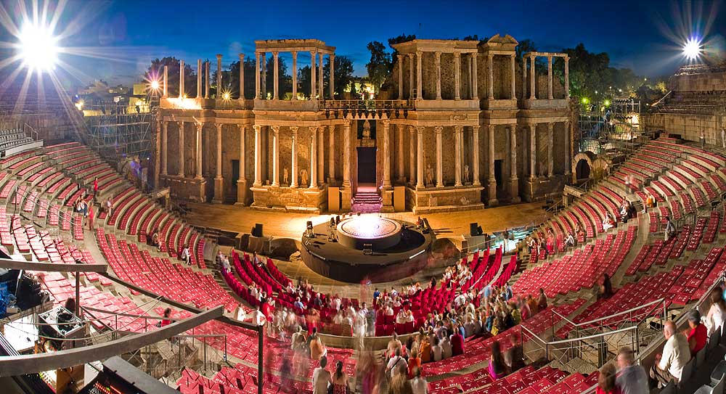
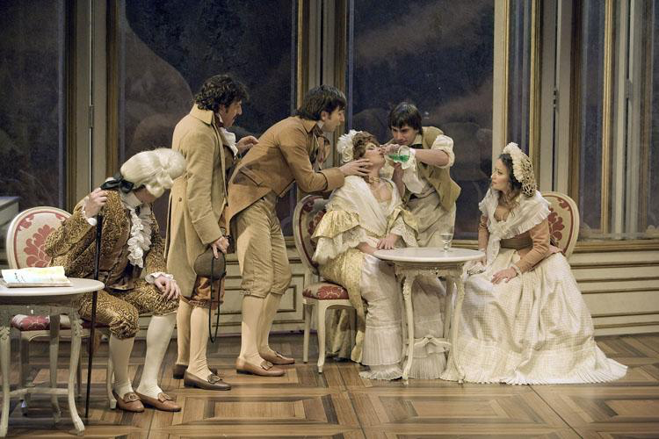

Slide 43
SURREALISM
The aim was to "resolve the previously contradictory conditions of dream and reality". Artists painted unnerving, illogical

Slide 44
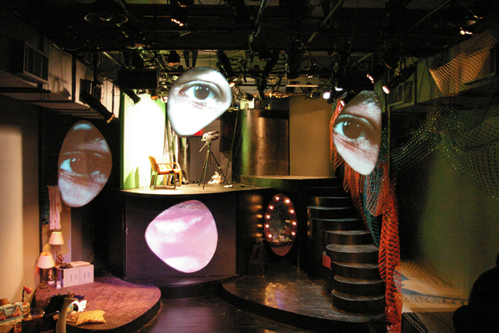
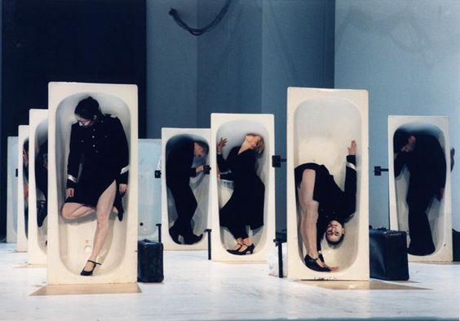
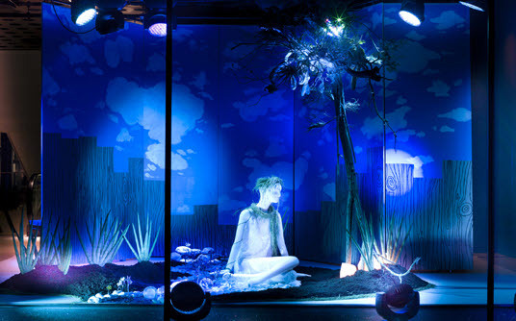

Slide 45
IMPRESSIONISM
Relies on the optical effects of light. unreal sights.

Slide 46
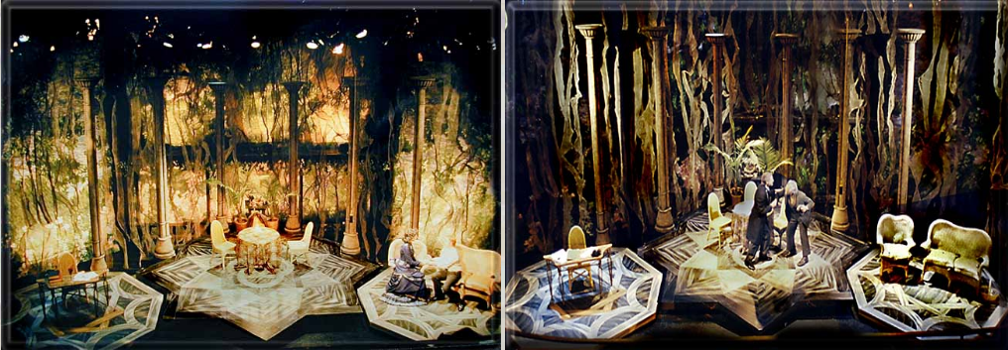

Slide 47
AVANT GARDE
Unusual ideas. pushes boundaries of norm
Modern art.
Promotes radical social reforms.

Slide 48
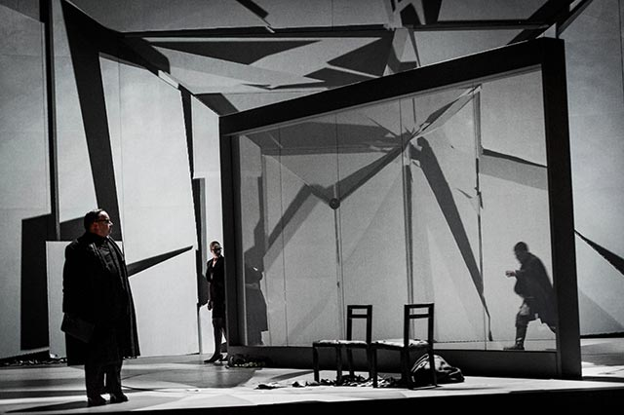
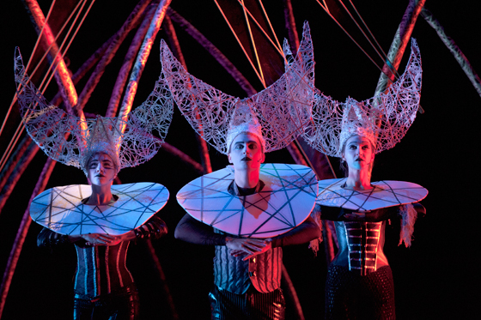

Slide 49
DESIGN ELEMENTS
Point - simplest and most fundamental design element. The beginning and the end. it commands attention to the observer
Line - continuous mark produced by a moving point.
Shape –composed of a line and a point. Organic and geometric
Mass - occupies space in all directions.
Color – involves light variation
Texture – surface quality of an object

Slide 50
ACTIVITY 2
Gather any organic materials in 15 mins

Slide 51
DESIGN PRINCIPLES
Are inherent in every work of art.
Balance – equality.
Asymmetrical
Symmetrical
Proportion – typically based on human sized scale.
Rhythm – A repetition on element that creates a sense of speed and movement.
Variation and Contrast – Altering the visula status quo
Unity and Harmony – the quality of oneness in the design

Slide 52
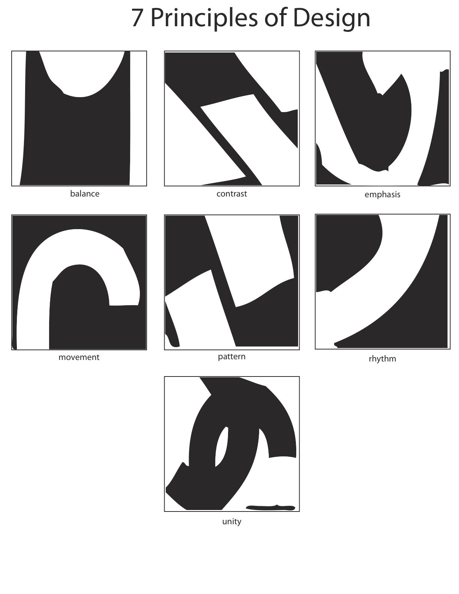

Slide 53
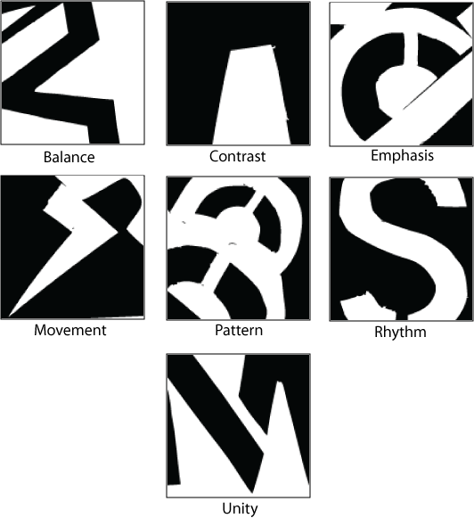

Slide 54
THEATER SPACES

Slide 55
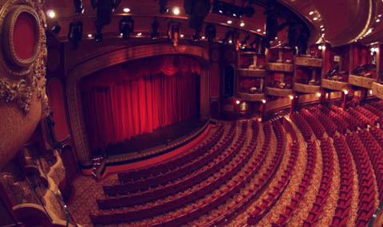
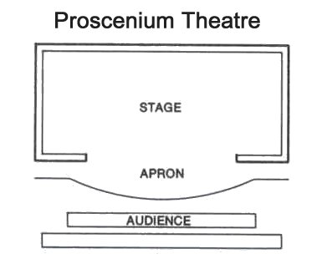
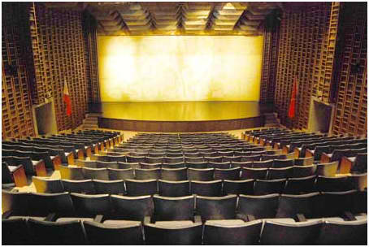
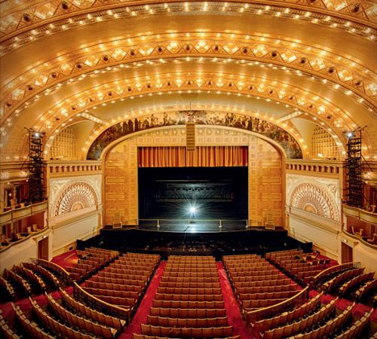
Proscenium theater

Slide 56
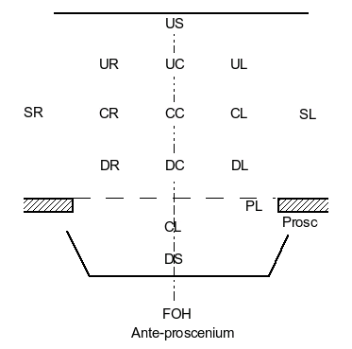

Slide 57
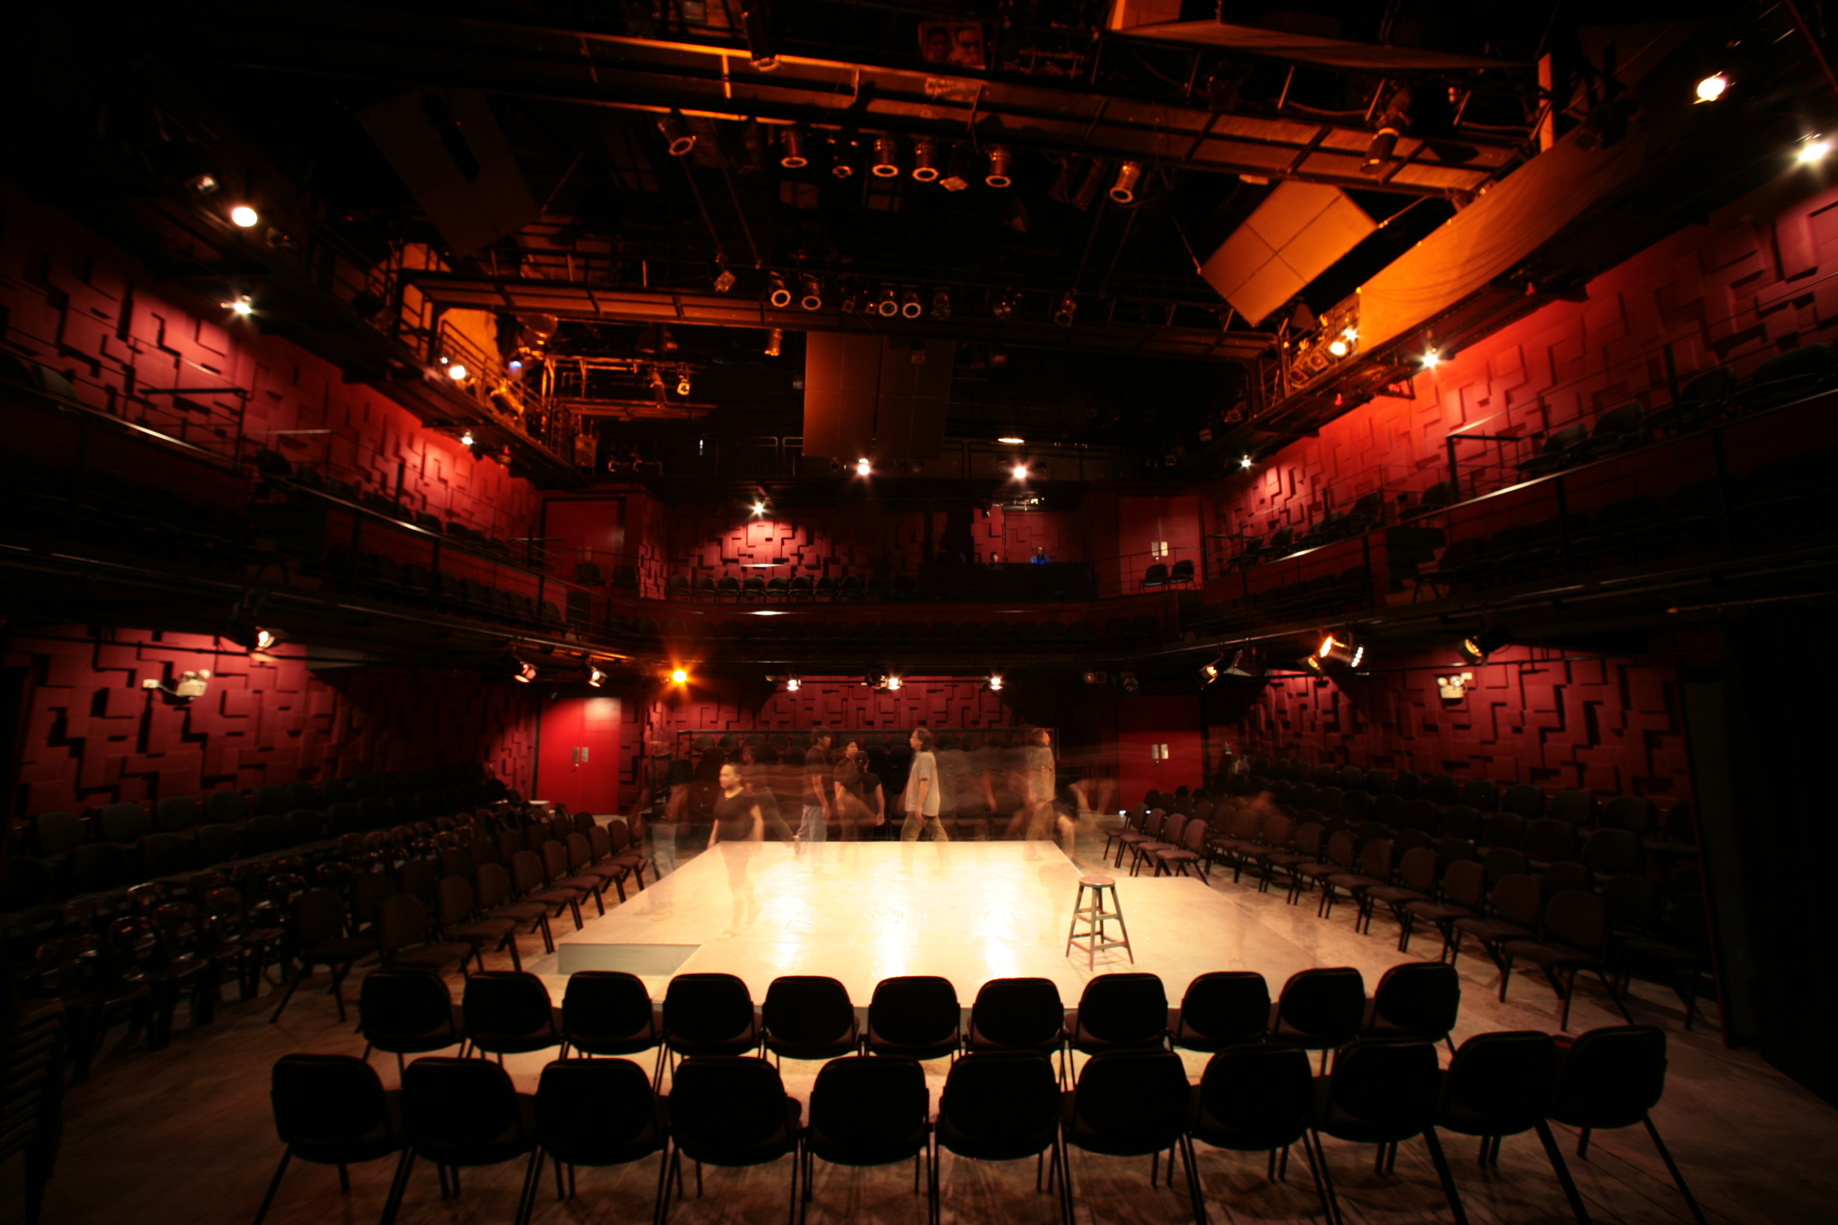
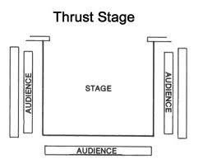
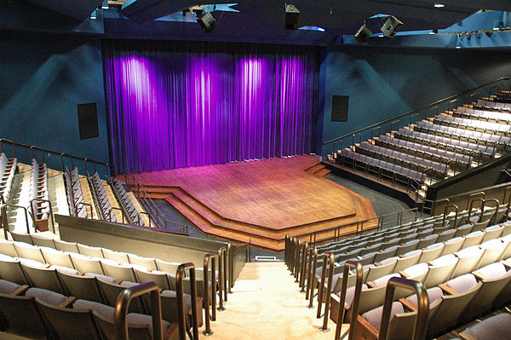
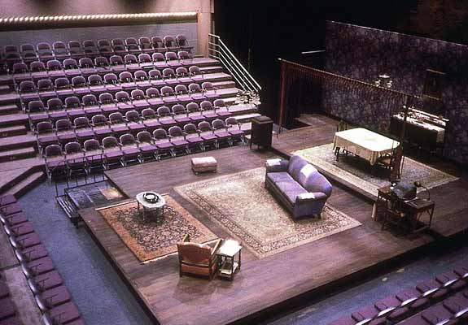
Thrust Theater

Slide 58
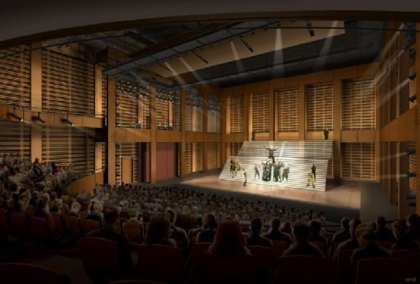
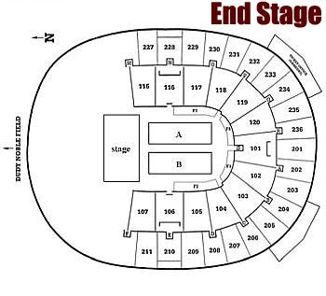
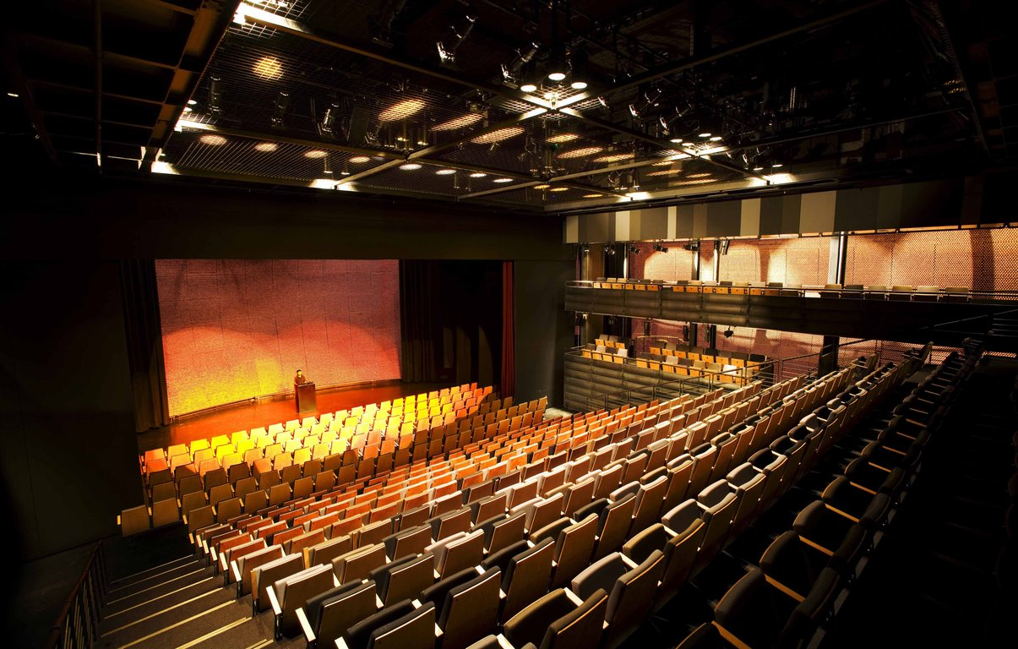
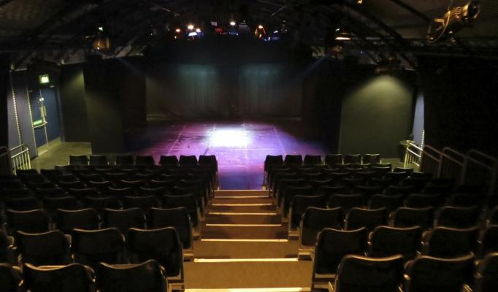
End Stage

Slide 59
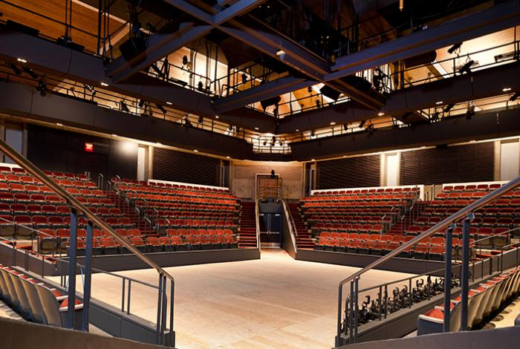
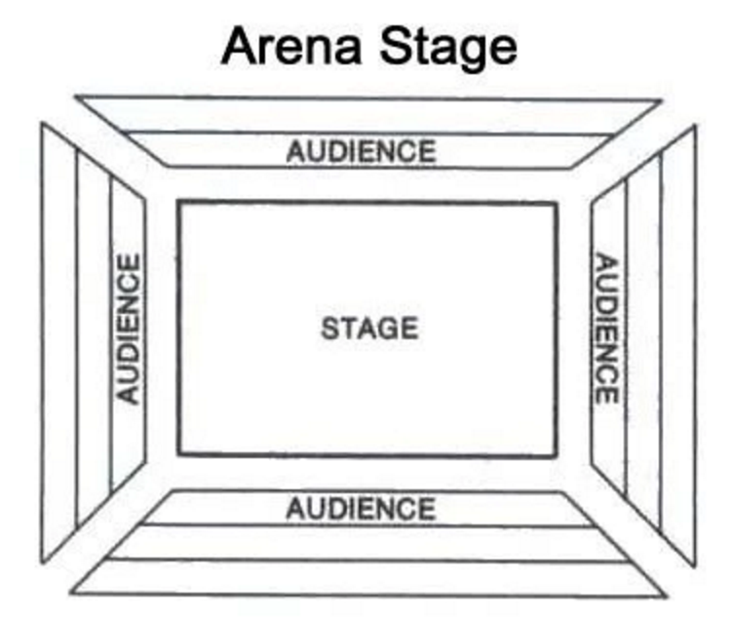
Arena

Slide 60
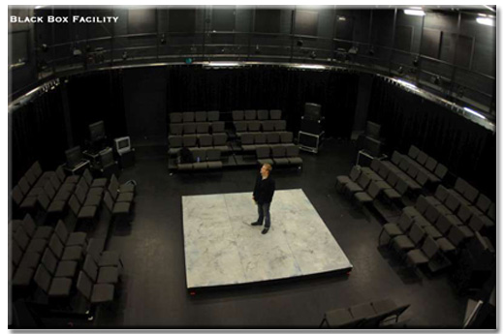
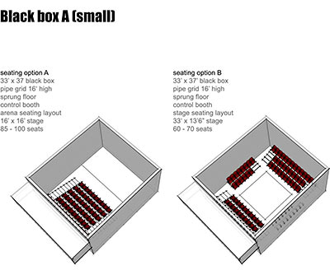
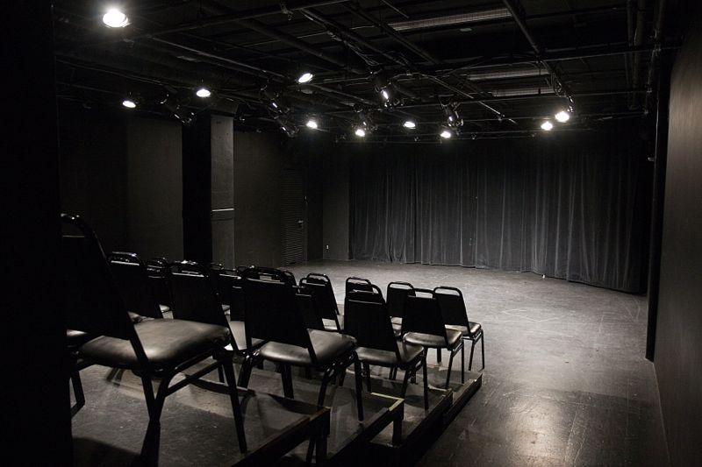
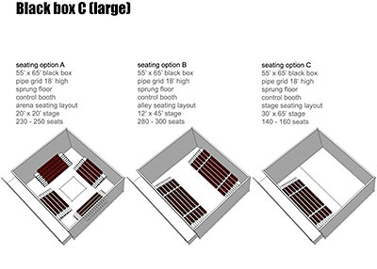
Flexible or Black box Theater

Slide 61
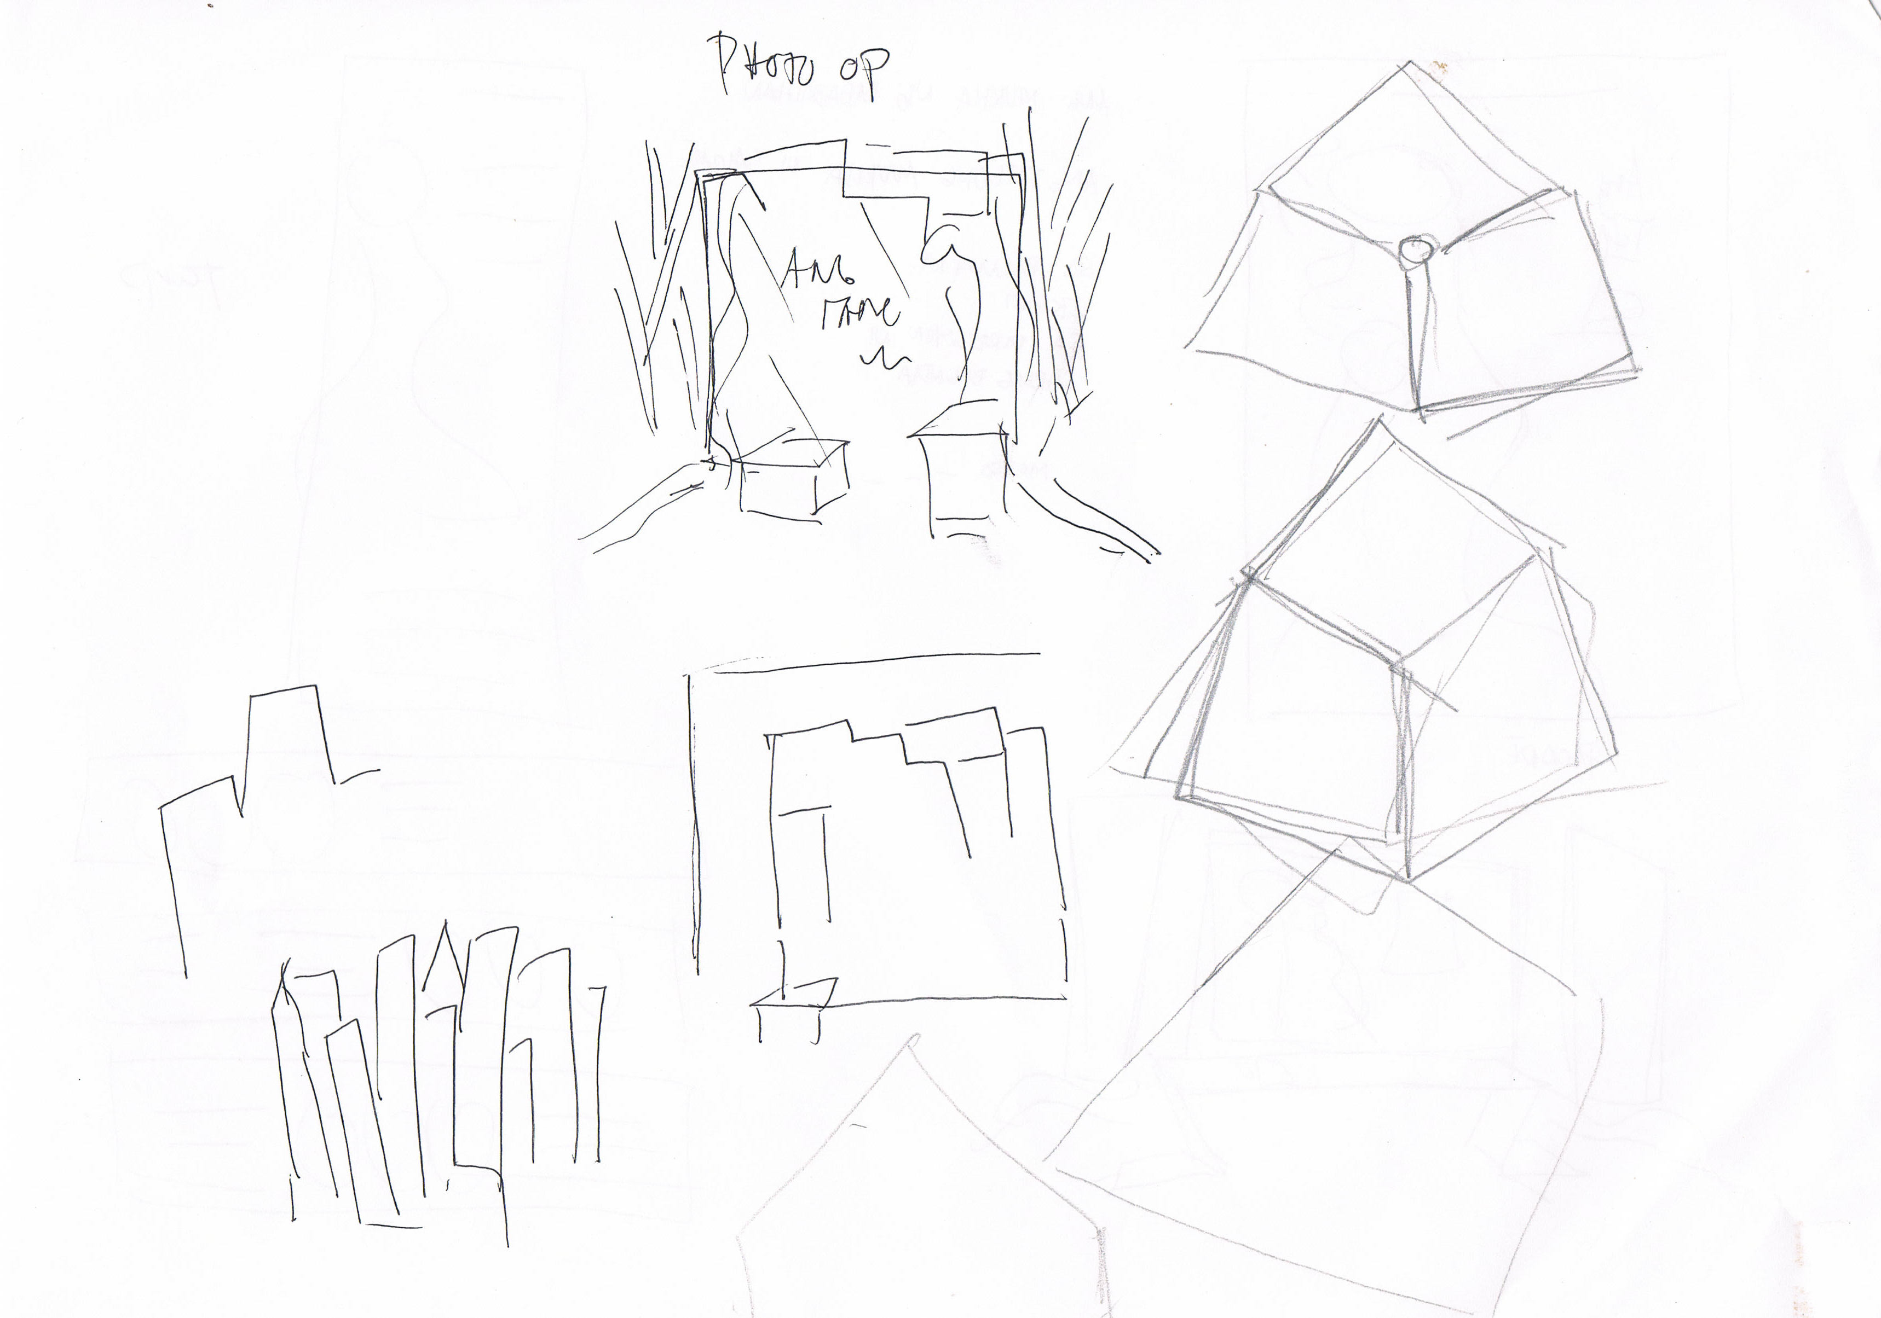

Slide 65
Set Props Lights Sounds Costume Graphic

Slide 66
UNIFIED DESIGNS
To tell the story in the most accurate way

Slide 67
UNIFIED DESIGNS
Creating Design Unity, when the design is unified the key elements have a sense of belonging together, a quality of oneness. Equal effort. Communication throughout the production.

Slide 68
ACTIVITY 3
Clay game

Slide 69
DESIGN ETIQUETTE
Audience POV
Must note: FOH, Collaterals, Branding and promotions
Avoid white floor and pure white costume
Avoid using formica or glossy paint
Safety
Always have a back up on everything
Must note entrance and exit

Slide 70
DESIGN ETIQUETTE
Be loyal to the concept.
Use theater make up
Darker colors
Visual composition
Positive and negative space
Less is More – a little bit goes a long way

Slide 72
WRAP UP
DESIGN RECONCILIATION

